Slide 1
ENVIRONMENTAL PHENOMENA IN KAMP-LINTFORT
PRESENTED BY:
BHUWAN ACHARYA 26129
BIKASH PAUDEL 26192
MD. ASHIKUL ISLAM 24387
MD. MONSUR ALI 24547
Applied Research Project - B
By Prof. Timo Kahl

Slide 2
AGENDA
INTRODUCTION
AIMS
METHODOLOGY
IMPLEMENTATION
ANALYSIS AND VISUALIZATION
SOLUTION AND DISCUSSION
CHALLENGES
CONCLUSION
REFERENCES

Slide 3
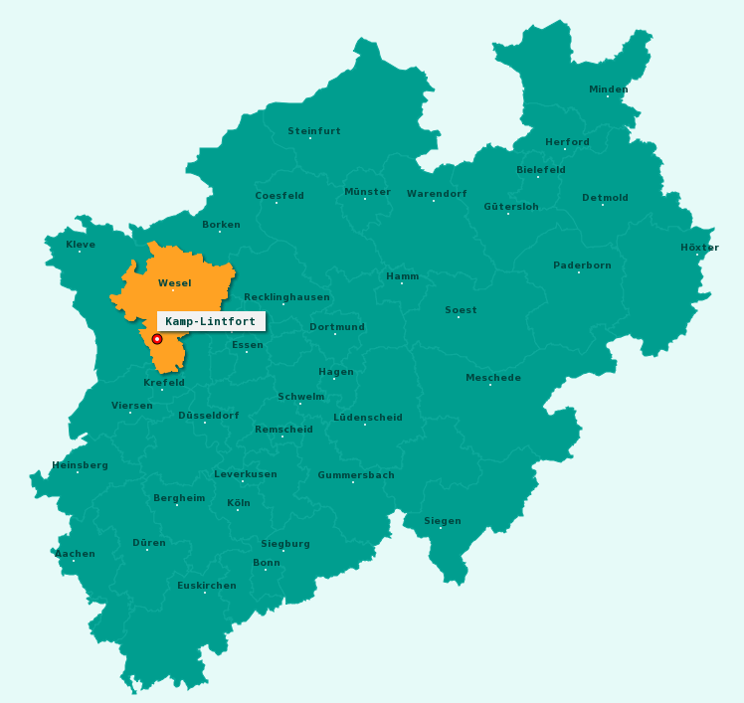
INTRODUCTION
KAMP-LINTFORT, A SMALL CITY IN WESEL DISTRICT
POPULATION AROUND 38,510, MOSTLY PERMANENT AND OLD INHABITANTS
NOT A BIG CITY, BUT ITS DISTRICTS ARE RATHER SCATTERED, SEPARATED BY GREEN MEADOWS, FIELDS AND FORESTS
A MINING TOWN FOR ALMOST 100 YEARS
FRIEDRICH HEINRICH ESTATE IS ONE OF THE BEST KNOWN
MINE WAS IN 2001 PART OF THE WEST COLLIERY OF THE RAG
CLOSED IN 31 DECEMBER 2012

Slide 4
INTRODUCTION
HOCHSCHULE RHEIN-WAAL, SINCE 2009
MANY STUDENTS COME TO KAMP-LINTFORT BECAUSE THE UNIVERSITY IS EQUIPPED WITH THE LATEST TECHNOLOGY AND OFFERS SPECIAL DEGREE PROGRAMMES
KLOSTER KAMP, EYLLER BERG
OLDER THAN THE MINERS’ ESTATES
TODAY IT’S A MUSEUM WHICH DRAWS NUMEROUS VISITORS EACH YEAR

Slide 5
INTRODUCTION
PEOPLE STILL UNAWARE ABOUT THE ENVIRONMENTAL CONDITION
TILL TODAY, NO ANY AIR QUALITY DATA CENTER
NO ANY RESEARCH HAS BEEN DONE YET
ENVIRONMENTAL AWARENESS NOT AN OPTION, A DUTY
“[A] CLEAN ENVIRONMENT IS A HUMAN RIGHT LIKE ANY
OTHER. IT IS THEREFORE PART OF OUR RESPONSIBILITY
TOWARD OTHERS TO ENSURE THAT THE WORLD WE
PASS ON IS AS HEALTHY, IF NOT HEALTHIER, THAN WE
FOUND IT”. (DALAI LAMA, 2017)

Slide 6
AIMS
MAKE PEOPLE AWARE
COMPARING WITH NEARBY CITIES
CORRELATION BETWEEN AIR QUALITY AND HEALTH HAZARD

Slide 7
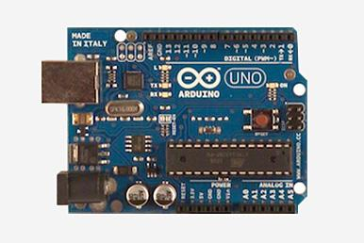
DEVICES
ARDUINO
AN OPEN-SOURCE ELECTRONICS PLATFORM BASED ON EASY-TO-USE HARDWARE AND SOFTWARE
SENSES THE ENVIRONMENT BY RECEIVING INPUT FROM SENSORS, AND AFFECTS THE ENVIRONMENT BY MOTORS AND OTHER ACTUATORS
MICROCONTROLLERS WE USED
ARDUINO UNO
MOST USED AND DOCUMENTED BOARD OF THE WHOLE ARDUINO FAMILY
BASED ON THE ATMEGA328P
HAS 14 DIGITAL INPUT/OUTPUT PINS
TINKER WITHOUT WORRYING TOO MUCH
REPLACE THE CHIP FOR A FEW DOLLARS
ARDUINO SMT32

Slide 8
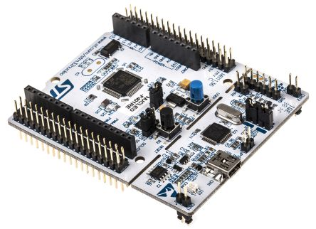
DEVICES
SMT32 NUCLEO F411RE
SUPPORT OF A WIDE CHOICE OF INTEGRATED DEVELOPMENT ENVIRONMENTS (IDES)
FLEXIBLE POWER-SUPPLY OPTIONS: ST-LINK USB VBUS OR EXTERNAL SOURCES
COMPREHENSIVE FREE SOFTWARE LIBRARIES AND EXAMPLES AVAILABLE
STM32 MICROCONTROLLER IN LQFP64 PACKAGE
512 KB Flash with 128 KB SRAM
1 USER LED SHARED WITH ARDUINO™
1 USER AND 1 RESET PUSH-BUTTONS

Slide 9
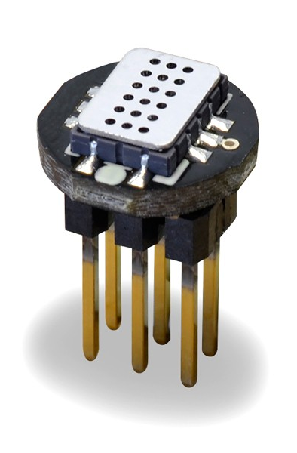
SENSORS
MICS 2714
SMALLEST FOOTPRINT FOR COMPACT DESIGNS (5 X 7 X 1.55 MM)
ROBUST MEMS SENSOR FOR HARSH ENVIRONMENTS
HIGH-VOLUME MANUFACTURING FOR LOW-COST APPLICATIONS
SHORT LEAD-TIMES
DETECTABLE GASES
NITROGEN DIOXIDE NO2 0.05 – 10PPM
HYDROGEN H2 1 – 1000 PPM

Slide 10
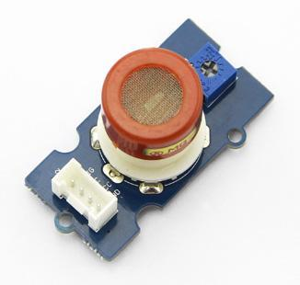
SENSORS
MQ-9
SENSITIVE FOR CARBON MONOXIDE
FAST RESPONSE AND RECOVERY
ADJUSTABLE SENSITIVITY
POWER: 5V ± 0.1
STABLE AND LONG LIFE

Slide 11
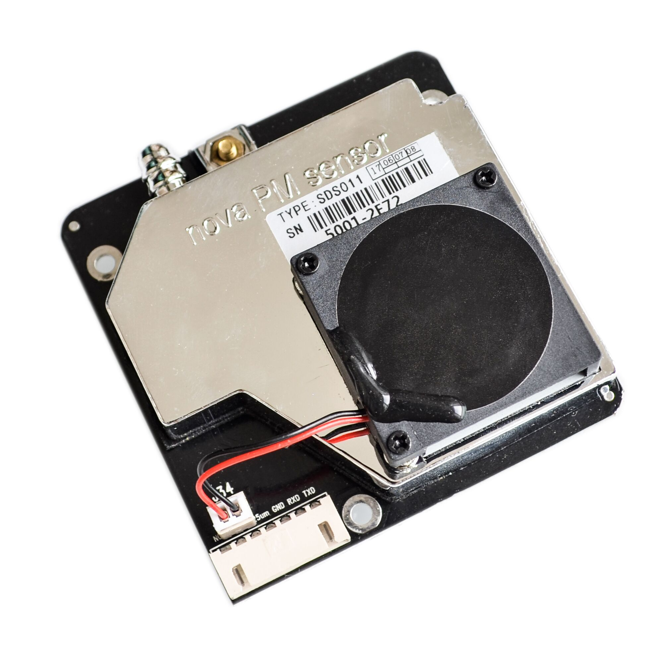
SENSORS
NOVA PM SDS 011(FOR PM_{2.5} AND PM₁₀ )
NEW AIR QUALITY SENSOR DEVELOPED BY INOVAFIT
ONE OF THE BEST SENSOR IN TERMS OF ACCURACY
OTHER SENSORS TEND TO FOCUS ON SHRINKING THE SENSOR SIZE
OPTED FOR A SIZE TRADEOFF ALLOWING IT TO USE A LARGER FAN
OUTPUT: PM2.5, PM10
MEASURING RANGE: 0.0-999.9ΜG/M3
INPUT VOLTAGE: 5V ± 0.1
RESPONSE TIME 1 SECOND
SERIAL DATA OUTPUT FREQUENCY: 1 TIME/SECOND
RELATIVE ERROR:10%

Slide 12

SERIAL TERMINAL
SERIAL TERMINAL
FULL-FEATURED TERMINAL EMULATION, BREAK SUPPORT AND FILE TRANSFERS
BUILT-IN, RELIABLE SUPPORT FOR ALMOST EVERY SERIAL DEVICE ON THE MARKET
MODERN, DEPENDABLE, AND POWERFULLY SIMPLE
MANUAL OR AUTOMATIC LOGGING FOR AUDITING OR DEBUGGING PURPOSE
CAPTURE TIMESTAMPS FOR RECEIVED DATA

Slide 13
R
LANGUAGE AND ENVIRONMENT FOR STATISTICAL COMPUTING, GRAPHICS AND IS HIGHLY EXTENSIBLE
STATISTICAL LIKE LINEAR AND NONLINEAR MODELLING, CLASSICAL STATISTICAL TESTS, TIME-SERIES ANALYSIS, CLASSIFICATION, CLUSTERING, …
FREE SOFTWARE UNDER THE TERMS OF THE FREE SOFTWARE FOUNDATION’S GNU GENERAL PUBLIC LICENSE IN SOURCE CODE FORM
COMPILES AND RUNS ON A WIDE VARIETY OF UNIX PLATFORMS AND SIMILAR SYSTEMS (INCLUDING FREEBSD AND LINUX), WINDOWS AND MAC OS
A WELL-DEVELOPED, SIMPLE AND EFFECTIVE PROGRAMMING LANGUAGE WHICH INCLUDES CONDITIONALS, LOOPS, USER-DEFINED RECURSIVE FUNCTIONS AND INPUT AND OUTPUT FACILITIES
A LARGE, COHERENT, INTEGRATED COLLECTION OF INTERMEDIATE TOOLS FOR DATA ANALYSIS,
GRAPHICAL FACILITIES FOR DATA ANALYSIS AND DISPLAY EITHER ON-SCREEN OR ON HARDCOPY

Slide 14
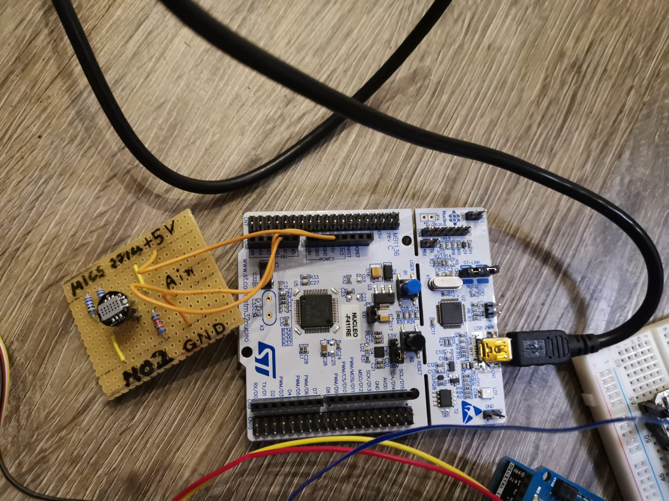
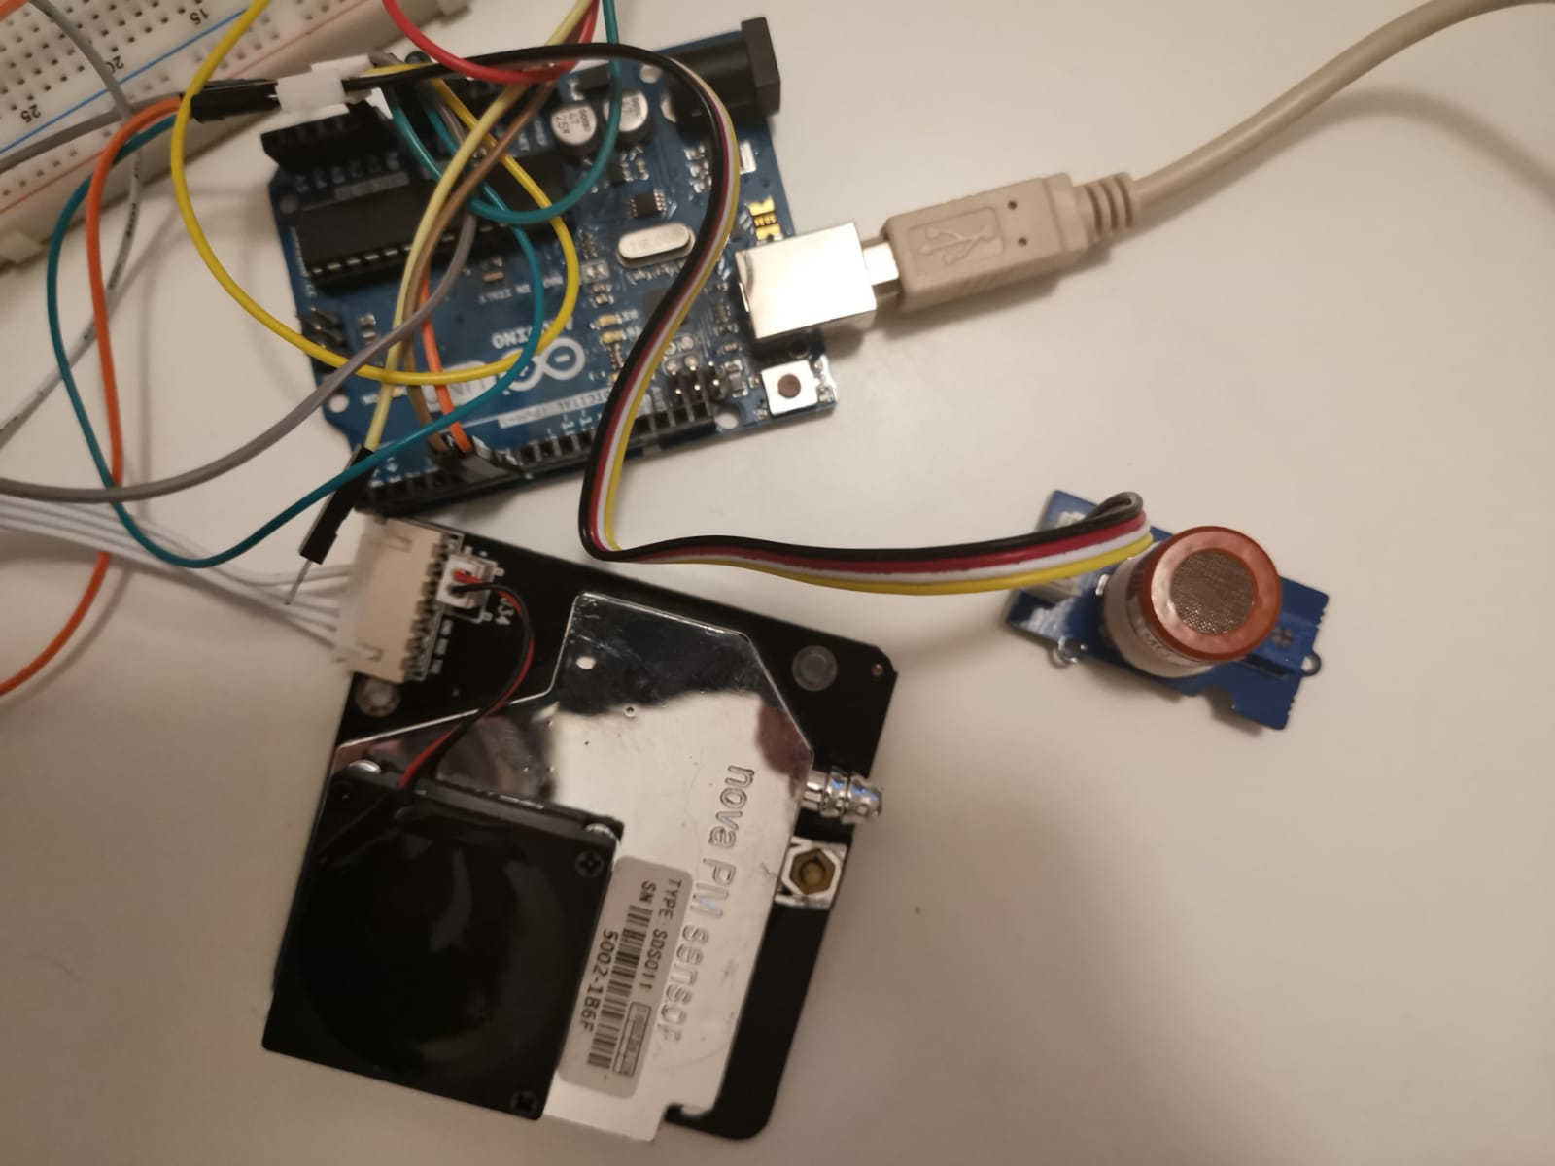
IMPLEMENTATION
ARDUINO IDE WAS USED FOR PROGRAMMING THE ARDUINO BOARDS
CONFIGURED ALL THE SENSORS AND BOARDS THEN PROGRAMMED
MICS 2714 SENSOR WAS OPERATED USING SMT32 NUCLEO-F411RE FOR NO2
MQ-9 AND PM SENSOR WAS OPERATED USING ARDUINO UNO FOR CO AND PM

Slide 15
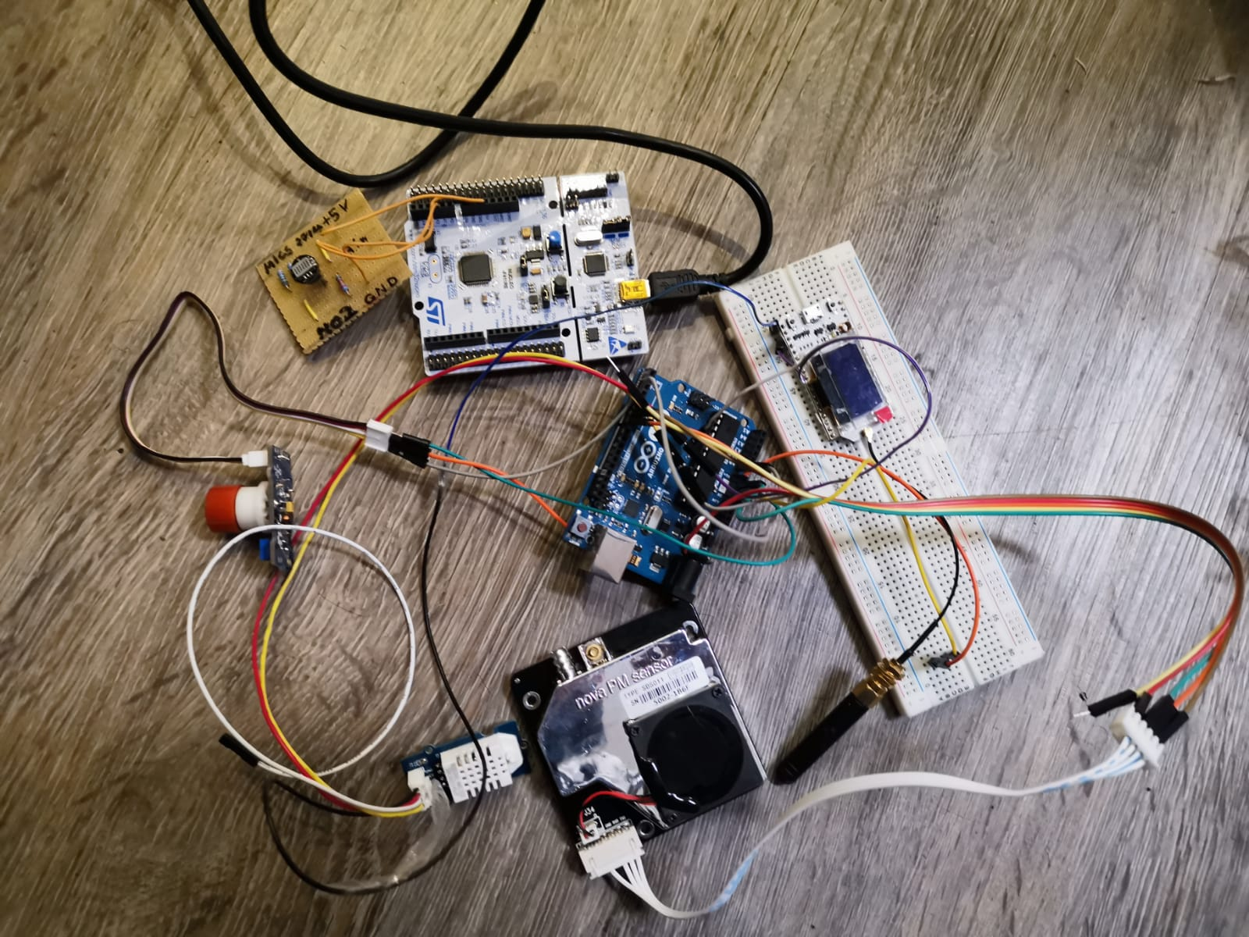
IMPLEMENTATION
OFFLINE DATA WAS COLLECTED BY SERIAL
EXCEL WAS USED FOR DATA PREPROCESSING
DATA WAS IMPORTED AND ANALYSED IN R
GRAPH AND OTHER VISUALIZATION WAS
MADE USING R
VARIETY OF GRAPH WAS MADE FOR
VISUALIZATION

Slide 16
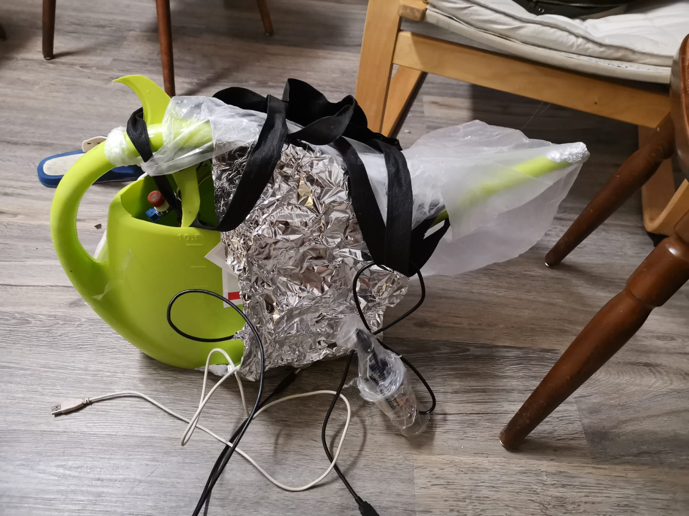
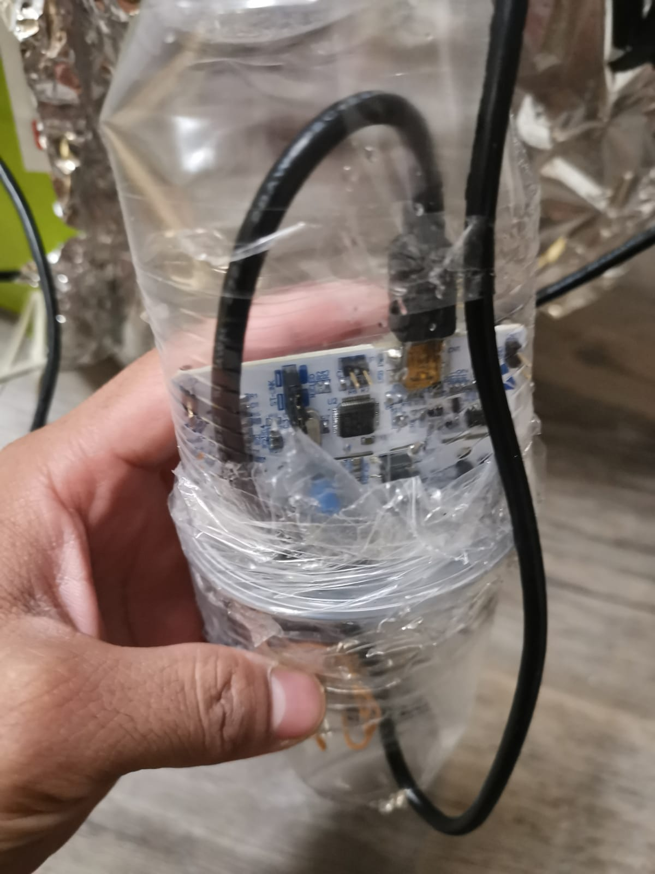
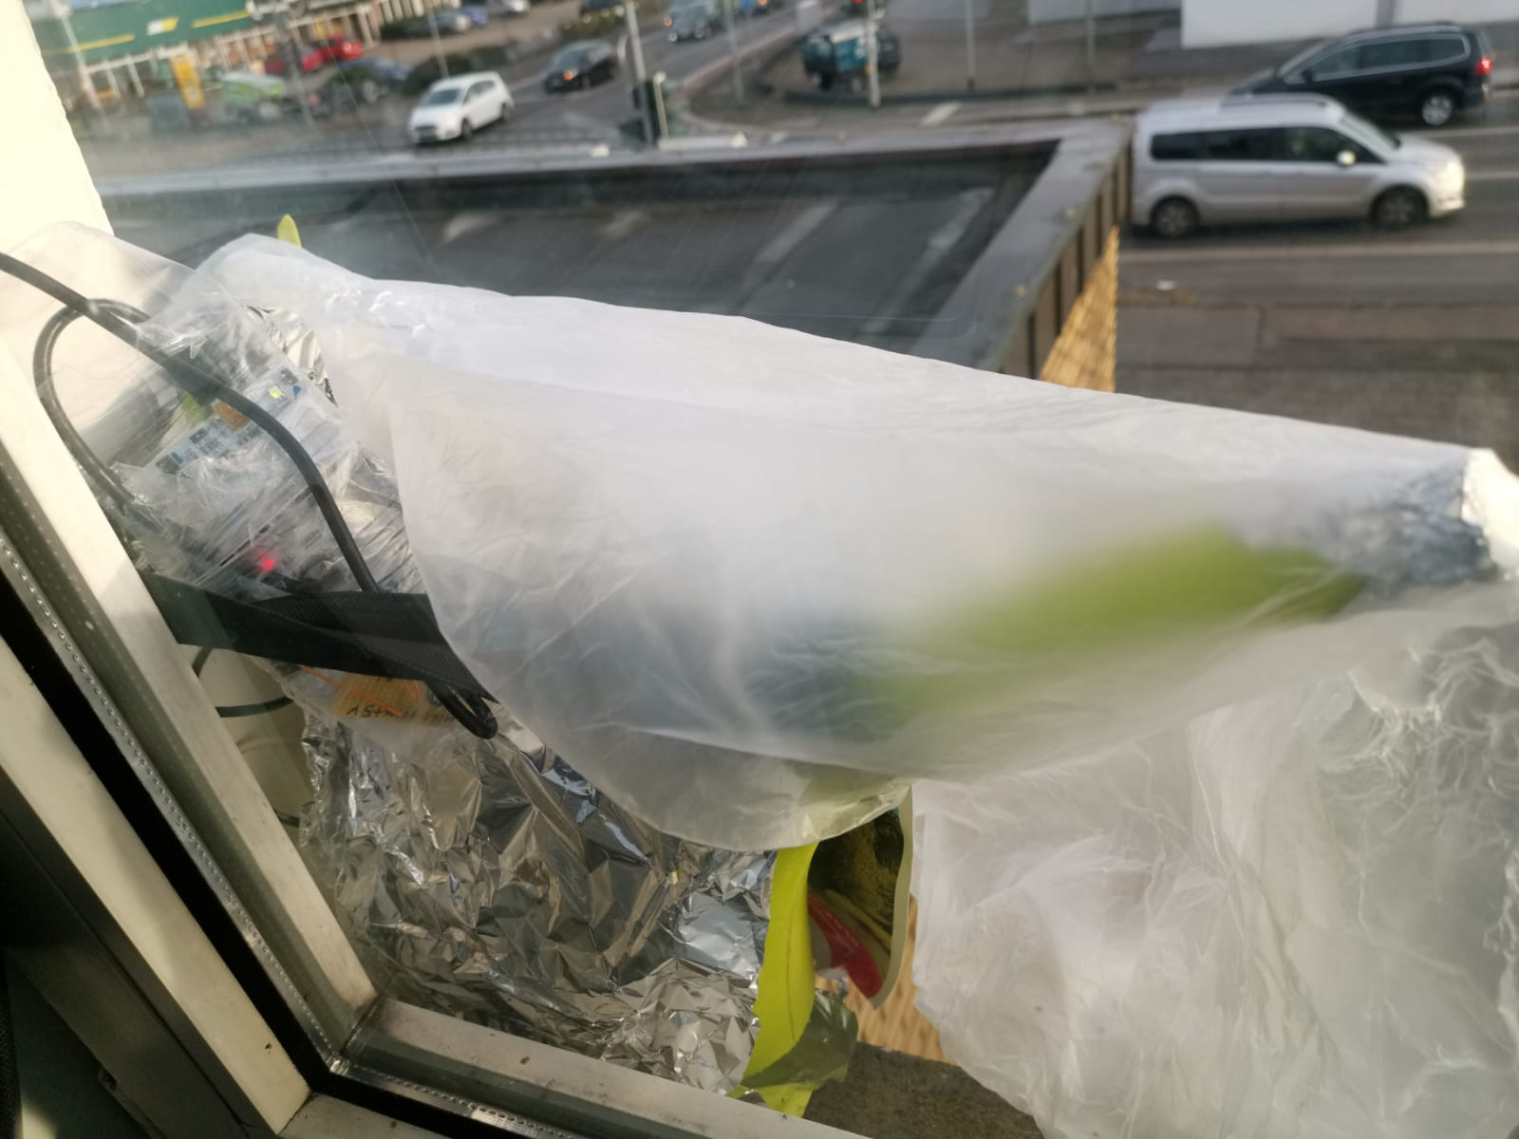
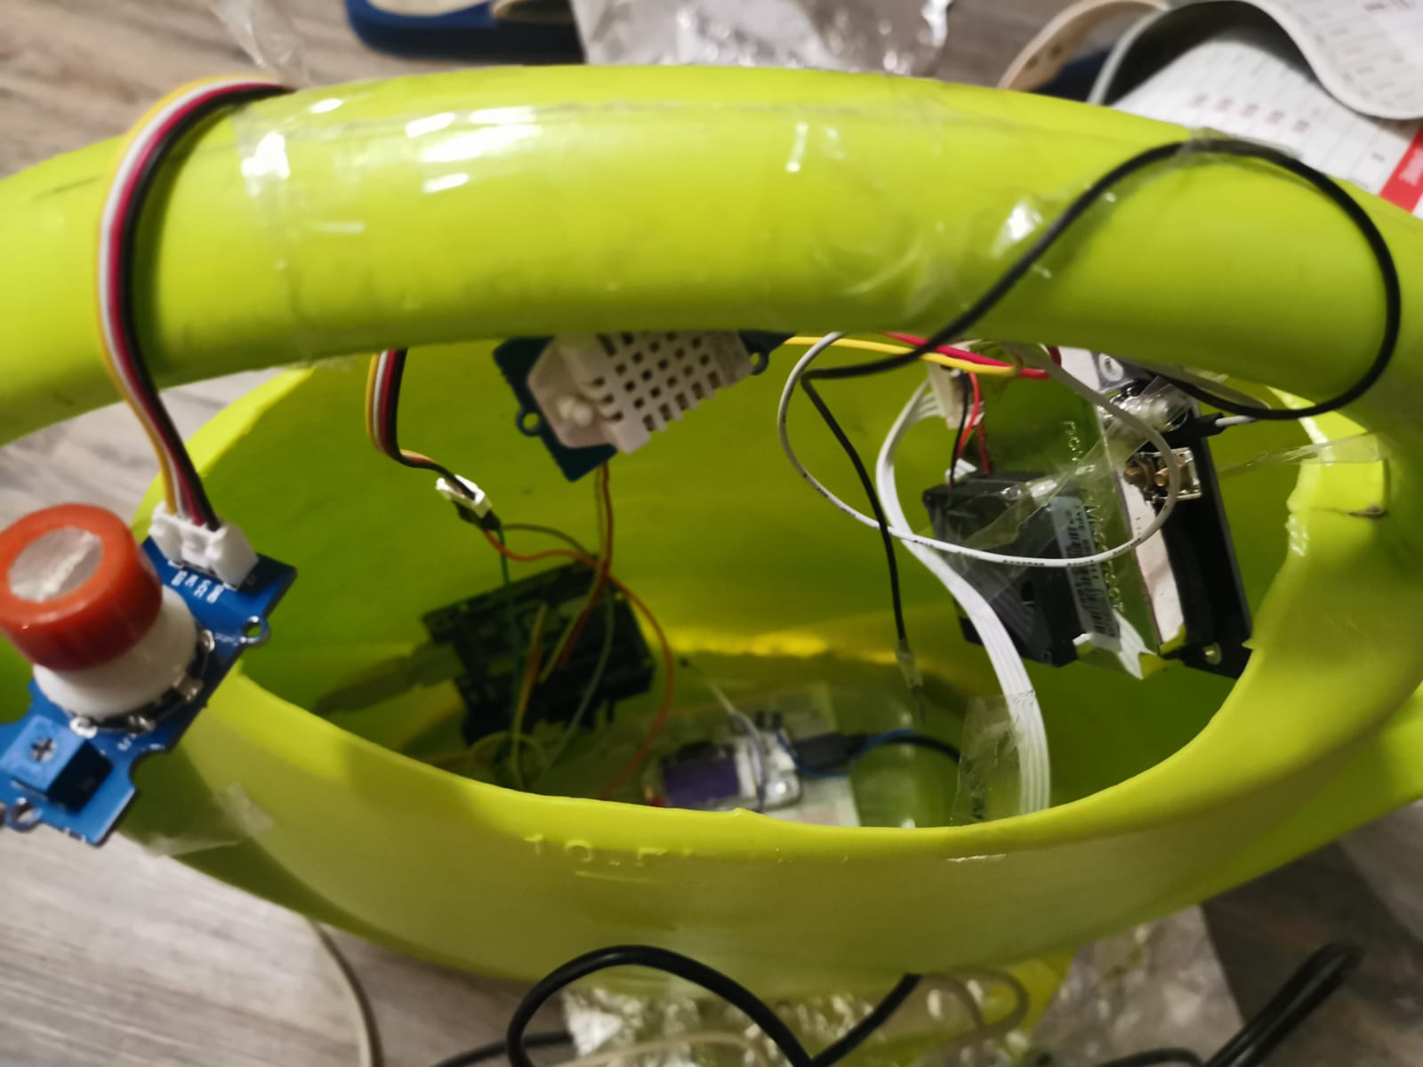
Data Collection
Kamp-Lintfort Data:
Address: Prinzenstraße,64,
Kamp-Lintfort,47475
Pollutants: PM₁₀ , PM_{2.5}, NO₂, CO
Collecting Date: 22-12-2018 to
04-01-2019
Other Cities Data: (Lanuv)
Address: Duisburg(Rheinhausen,
Marktstraße, 47158), Krefeld(Hentrichstraße,
47809), Wesel(Feldmark, 46485)
Pollutants: , NO_{2 ,}PM₁₀
Collecting Date: 22-12-2018 to
04-01-2019

Slide 17
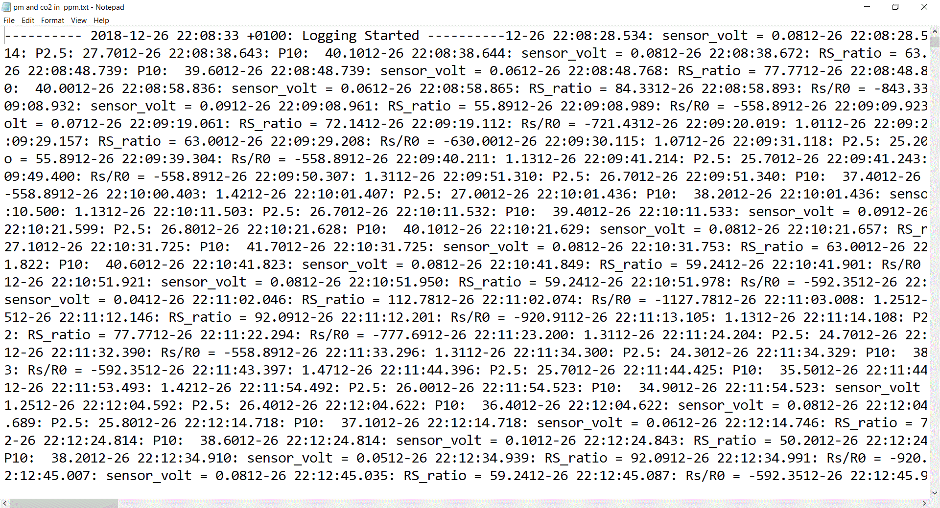
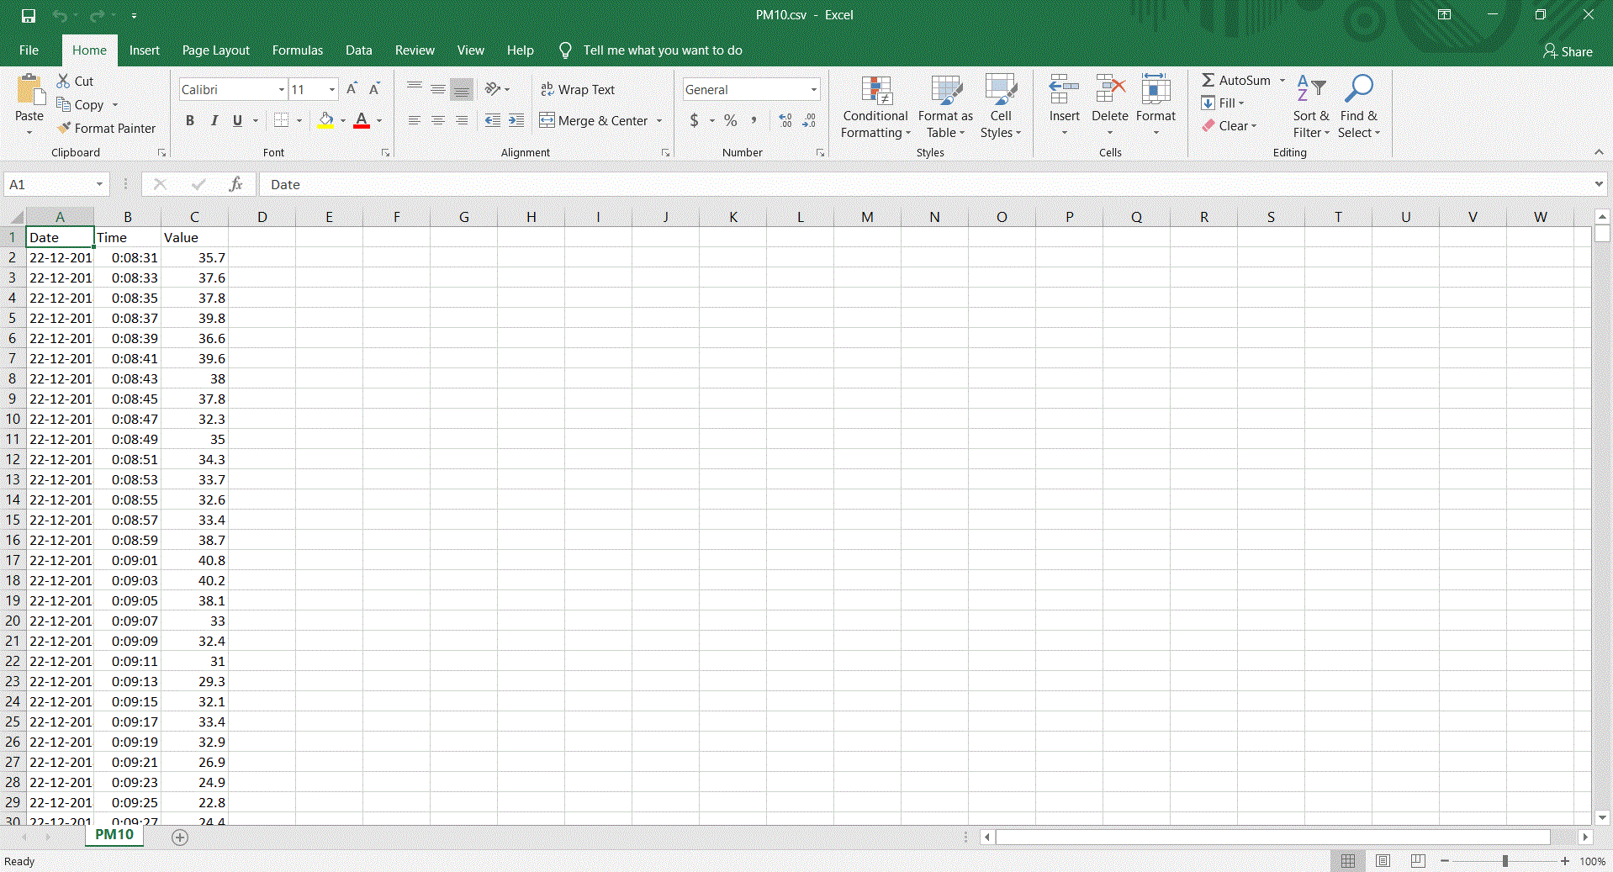
DATA COLLECTION

Slide 18
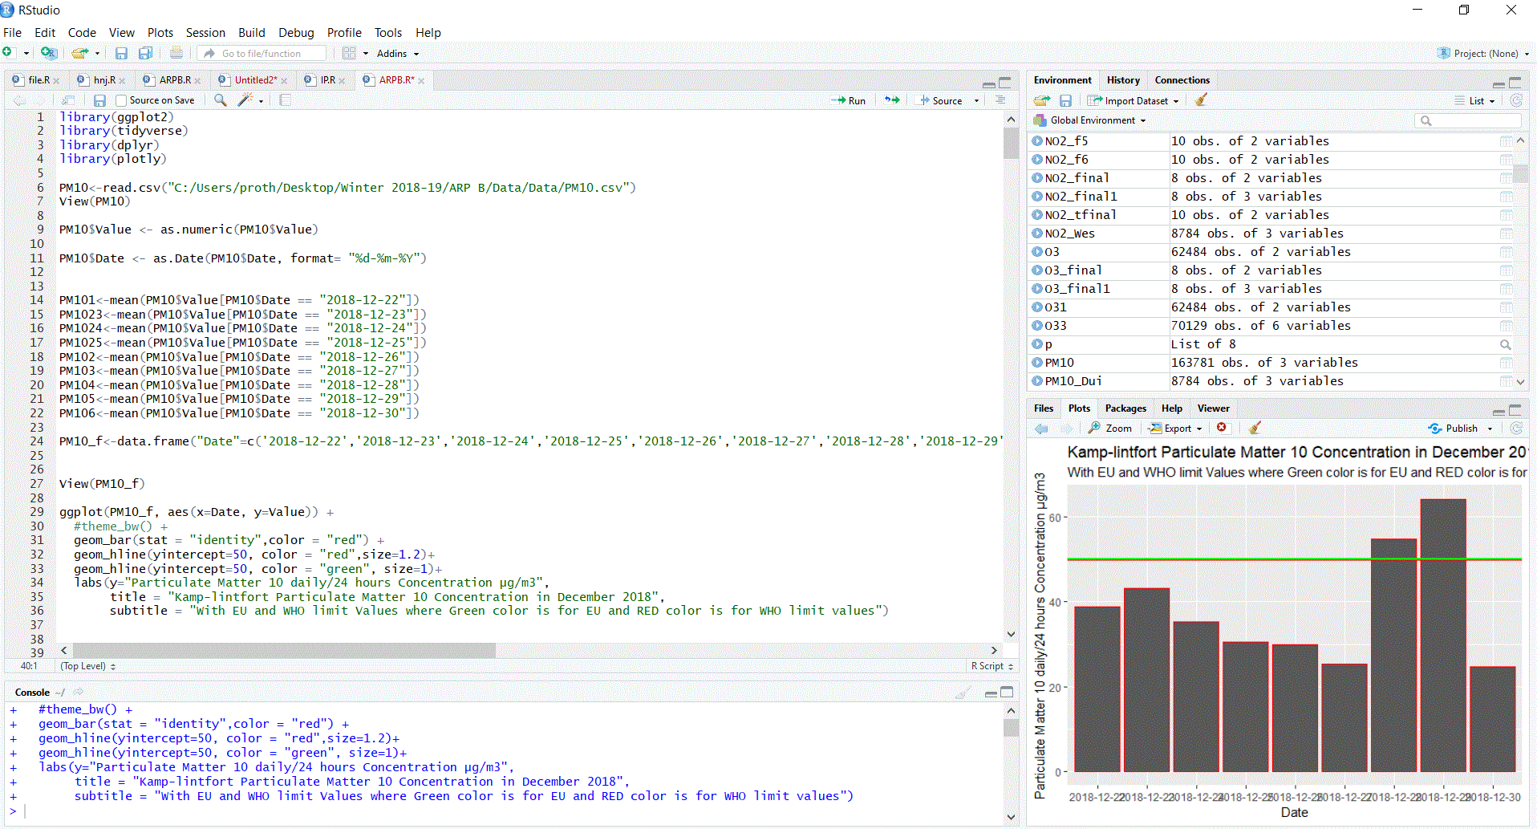
DATA VISUALIZATION

Slide 19
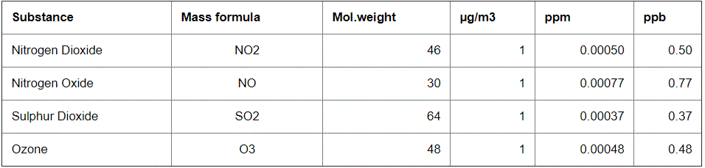
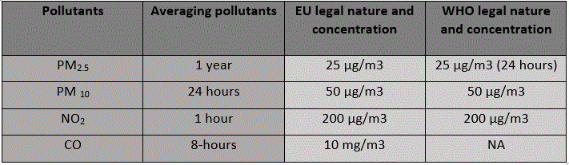
AIR QUALITY STANDARD VALUES
Data Conversion
Air quality Standard
Values:

Slide 20
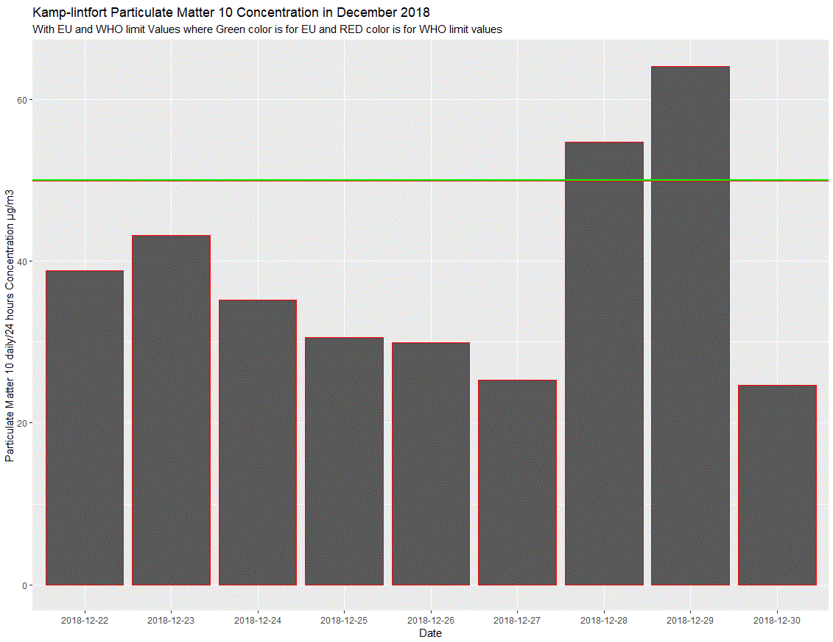
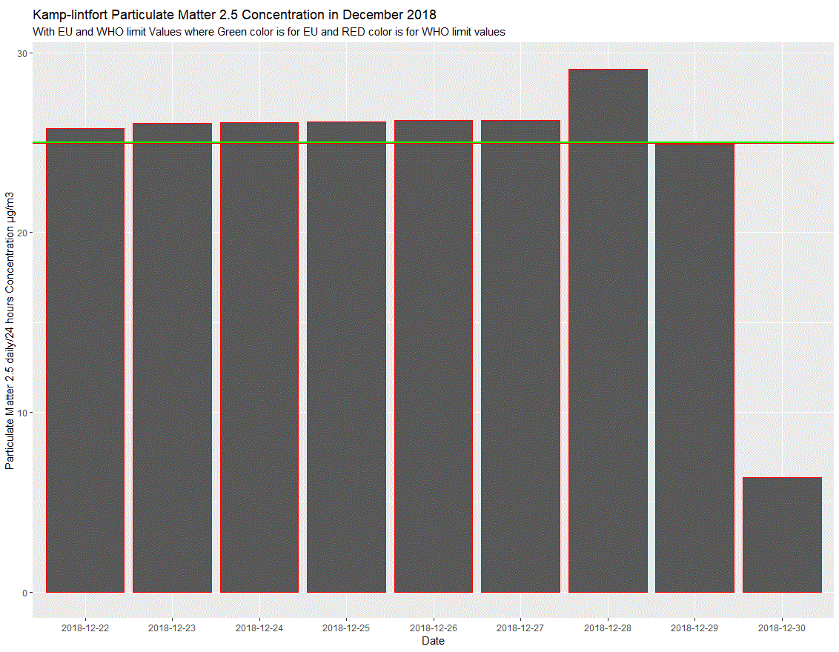
KAMP-LINTFORT PM₁₀ AND PM_{2.5} CONCENTRATION
Total concentration: for PM₁₀ and PM_{2.5} total concentration is 163782

Slide 21
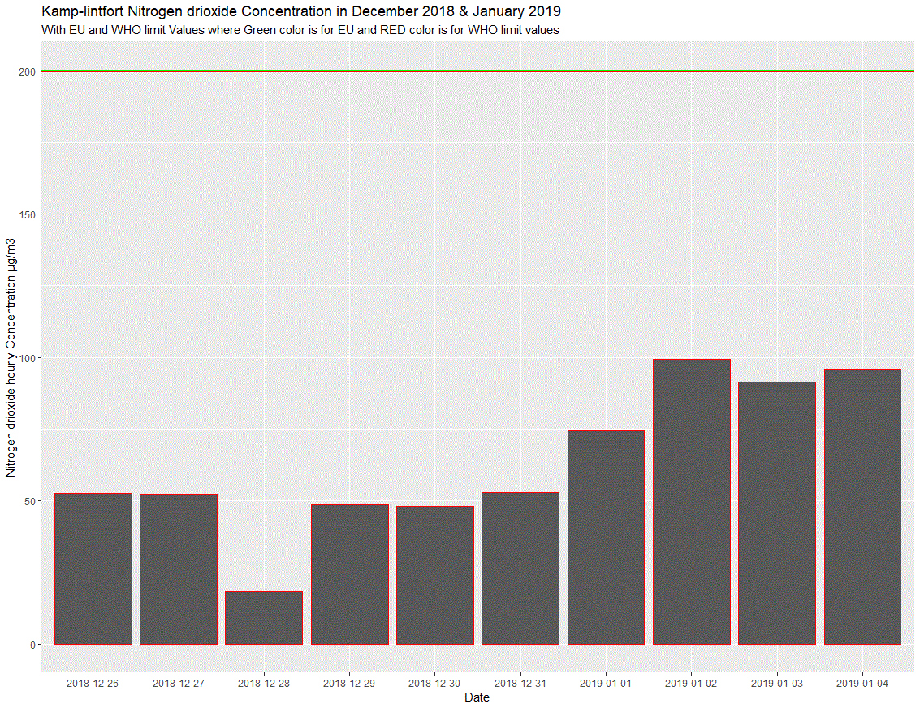
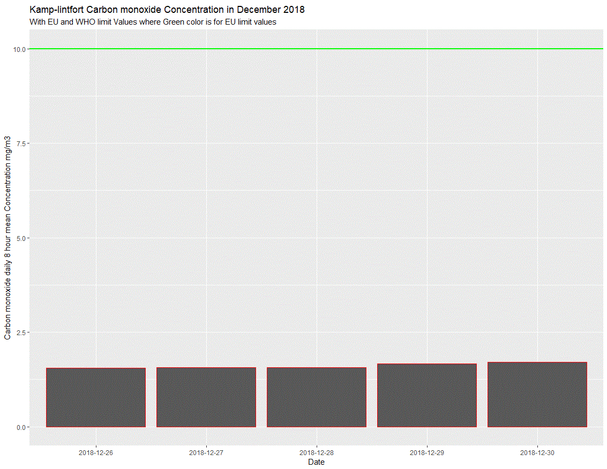
KAMP-LINTFORT NO₂ AND CO CONCENTRATION
Total concentration: for NO₂ total concentration is 320940 and CO total concentration is 160471

Slide 22
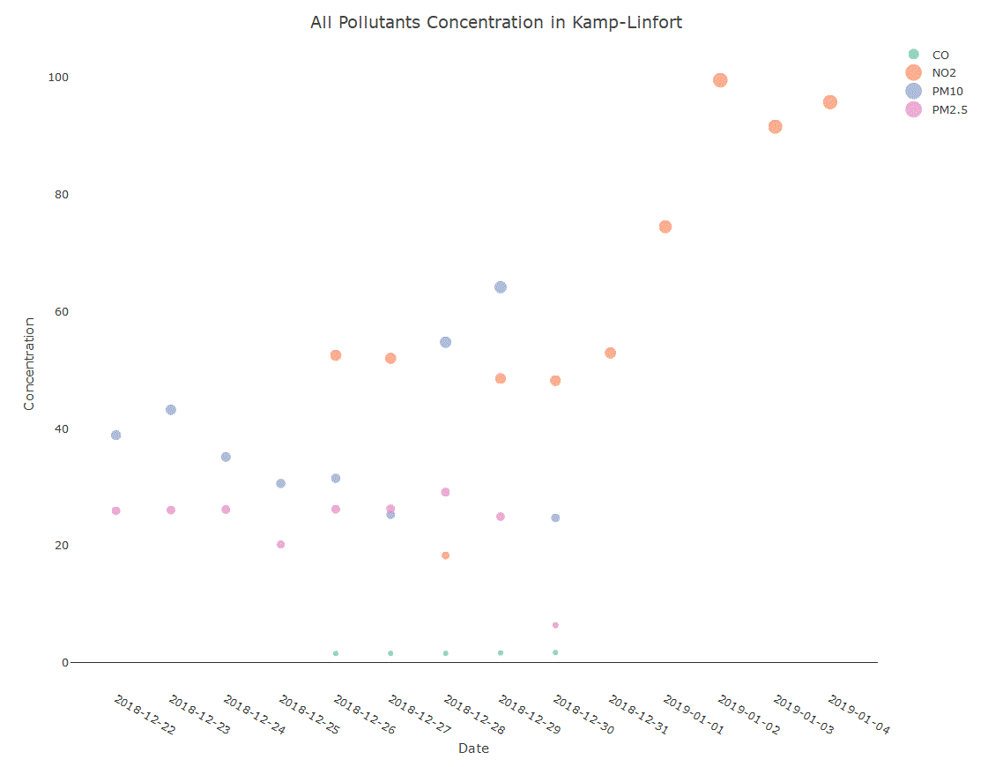
ALL POLLUTANTS CONCENTRATION IN KAMP-LINTFORT

Slide 23
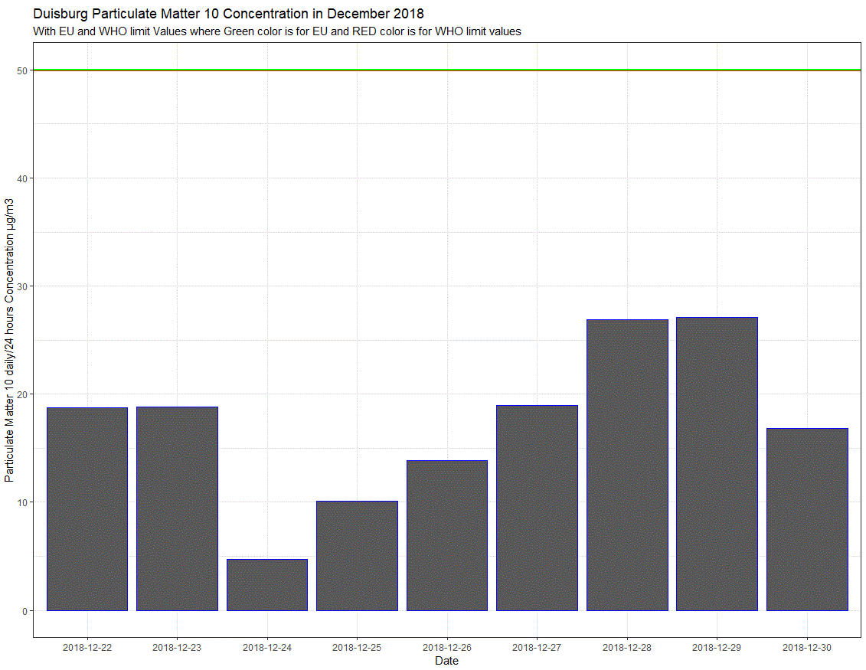
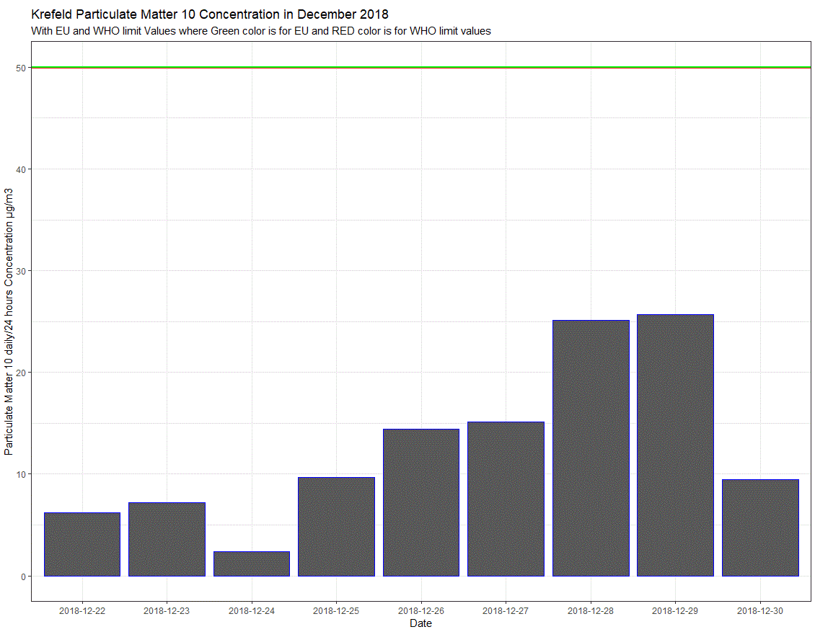
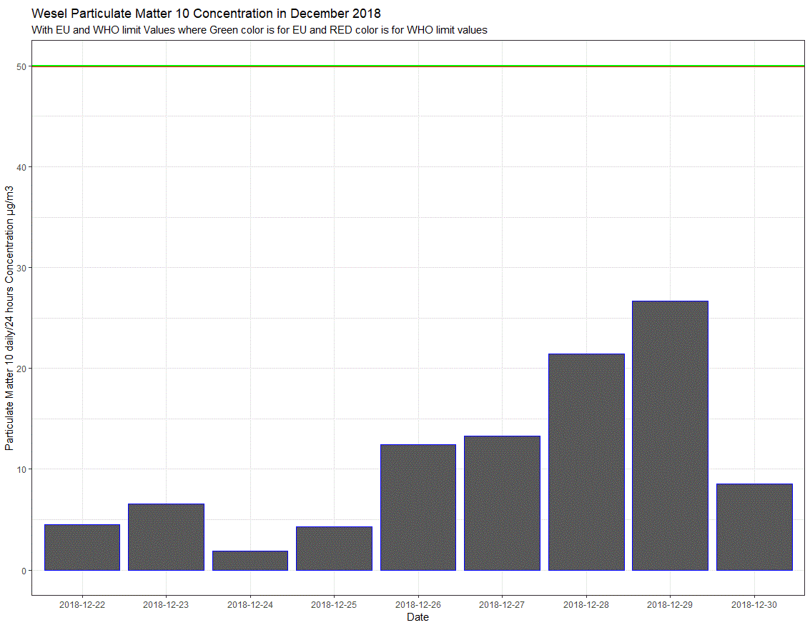
DUISBURG, KREFELD AND WESEL PM₁₀ CONCENTRATION

Slide 24
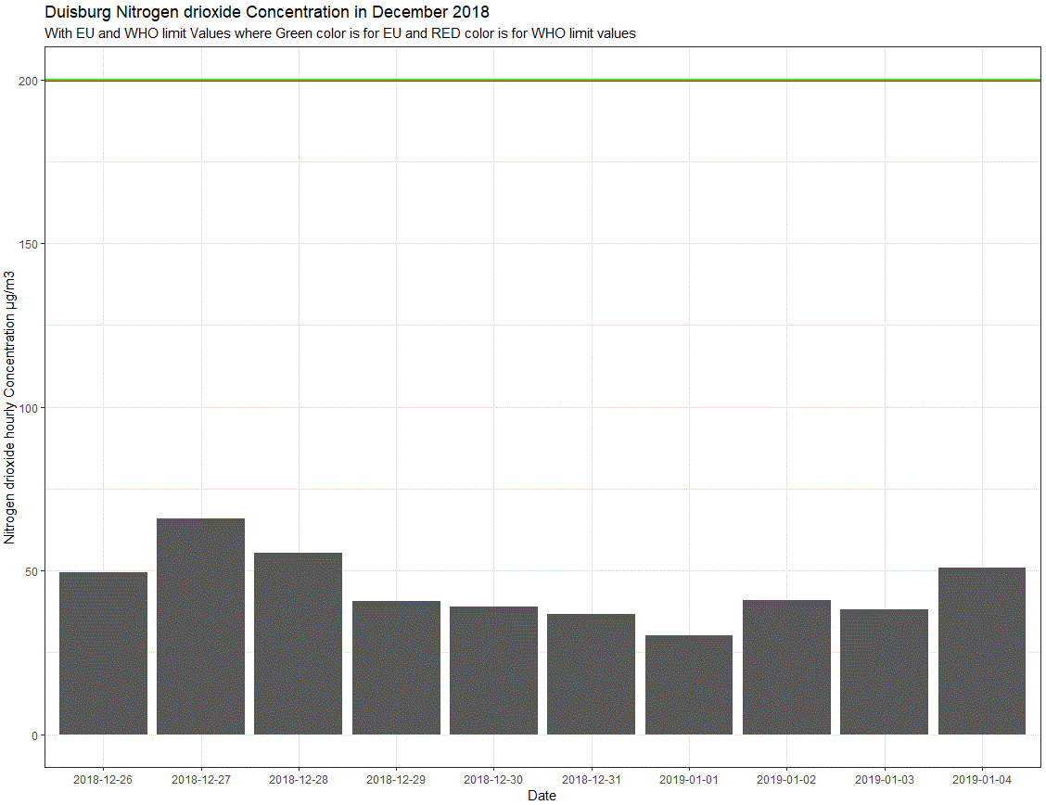
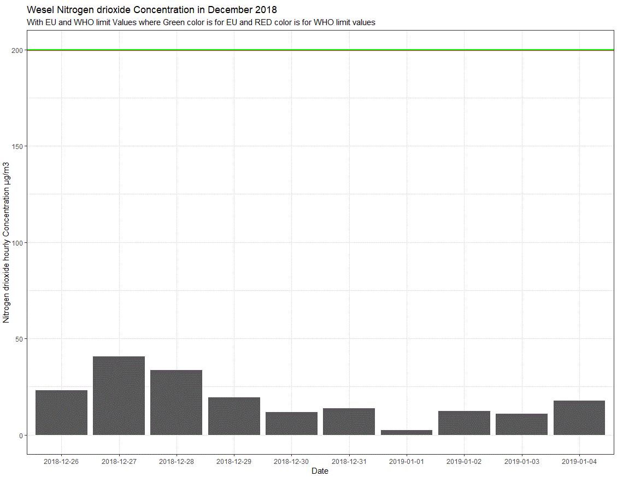
DUISBURG AND WESEL NO₂ CONCENTRATION

Slide 25
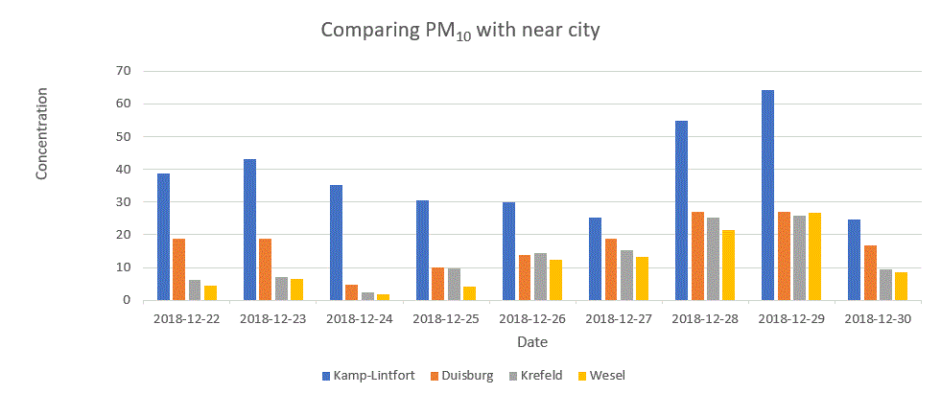
COMPARING KAMP-LINTFORT PM₁₀ WITH OTHER CITIES

Slide 26
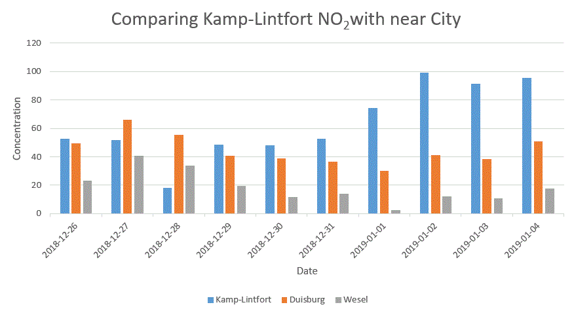
COMPARING KAMP-LINTFORT NO₂ WITH OTHER CITIES

Slide 27
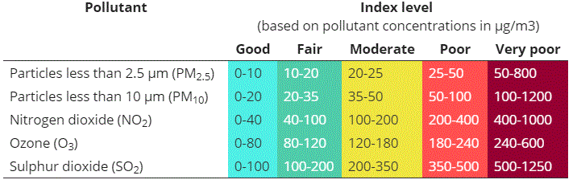
EEA AIR QUALITY HEALTH CONCERN INDEX

Slide 28
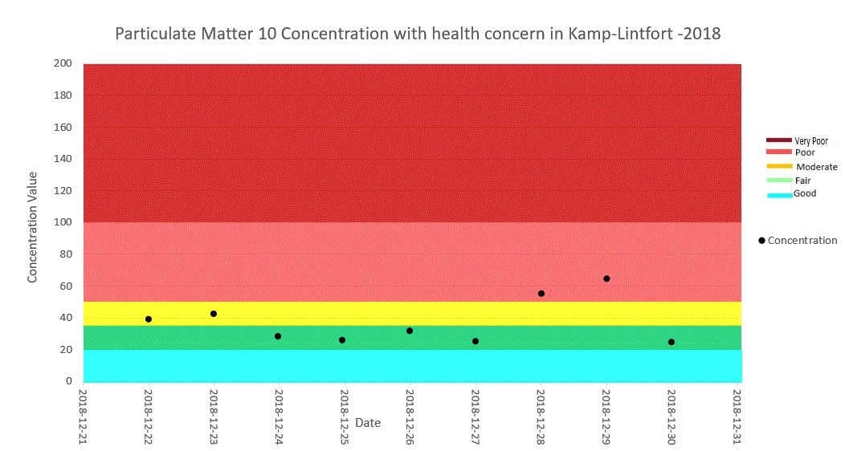
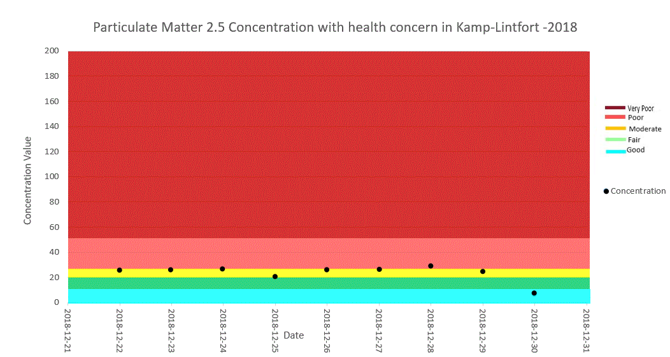
PM₁₀ AND PM_{2.5} CONCENTRATION WITH HEALTH CONCERN

Slide 29
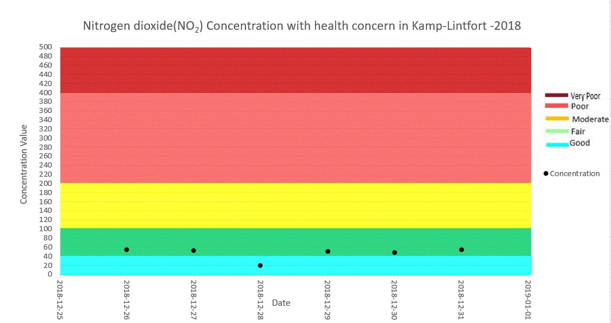
NO₂ CONCENTRATION WITH HEALTH CONCERN

Slide 30
HEALTH EFFECTS DUE TO PM₁₀ AND PM_{2.5}
IRRITATION IN EYES, NOSE AND THROAT
SHORTNESS OF BREATH, COUGHING
LUNG FUNCTION REDUCTION
IRREGULAR HEART BEATING
ASTHMA ATTACK
PREMATURE DEATH

Slide 31
CHALLENGES
FINDING THE SUITABLE SENSORS AND A PLACE TO PLANT THE SENSORS
DIFFICULT OF HANDLE THE SENSORS
LIMITED TOOLS FOR EXTRACTING THE DATA AND STORE OFFLINE
UNABLE TO MAP THE DATA ONLINE DUE TO NETWORK CONFIGURATION NEEDS FOR GATEWAY

Slide 32
SOLUTION AND DISCUSSIONS
SUCCESSFUL IMPLEMENTATION OF SENSORS
DATA COLLECTED OFFLINE
DATA FROM DIFFERENT LOCATIONS OF KAMP-LINTFORT UNSUCCESSFUL
COMPARISON DATA OF DIFFERENT LOCATIONS OF KAMP-LINTFORT UNSUCCESSFUL
ANALYSIS AND VISUALIZATION WAS DONE
COMPARISON WITH THE STANDARD VALUE WAS DONE
COMPARISON WITH DIFFERENT CITIES WERE PERFORMED

Slide 33
CONCLUSION
HOW GOOD IS THE ENVIRONMENT CONDITION FOUND BY OUR PROJECT WITH RESPECT TO STANDARD BY WHO AND EU AND ALSO AMONG THE OTHER CITIES
THE QUALITY OF PM₁₀ AND PM_{2.5} IS NOT THAT MUCH GOOD ENOUGH
THE QUALITY OF NO₂ AND CO IS FAIRLY GOOD
THE WORST AIR QUALITY COMPARING TO OTHER NEARBY CITIES

Slide 34
REFERENCES
KAMP-LINTFORT. (N.D.B). STADTGESCHICHTE. RETRIEVED FROM WWW.KAMP-LINTFORT.DE/DE/INHALT/GESCHICHTE/ (04.01.2019)
AIR QUALITY IN EUROPE — 2017 REPORT OR HTTP://EC.EUROPA.EU/ENVIRONMENT/AIR/QUALITY/STANDARDS.HTML
WHO AIR QUALITY GUIDELINES (AQG) WWW.WHO.INT/NEWS-ROOM/FACT-SHEETS/DETAIL/AMBIENT-(OUTDOOR)-AIR-QUALITY-AND-HEALTH
WWW.UMWELTSCHUTZ.DE/
WWW.LANUV.NRW.DE/UMWELT/LUFT/IMMISSIONEN/BERICHTE-UND-TRENDS/EINZELWERTE-KONTINUIERLICHER-MESSUNGEN/

Slide 35
REFERENCES
ARDUINO UNO REV3, STORE.ARDUINO.CC/ARDUINO-UNO-REV3.
“NUCLEO-F411RE .” STM32F0DISCOVERY - DISCOVERY KIT WITH STM32F051R8 MCU - STMICROELECTRONICS, WWW.ST.COM/EN/EVALUATION-TOOLS/NUCLEO-F411RE.HTML
WWW.SGXSENSORTECH.COM/CONTENT/UPLOADS/2014/08/1107_DATASHEET-MICS-2714.PDF
WWW.POLOLU.COM/FILE/0J313/MQ7.PDF
THE WORLD AIR QUALITY INDEX PROJECT. “THE SDS011 AIR QUALITY SENSOR EXPERIMENT.” AQICN.ORG, AQICN.ORG/SENSOR/SDS011
“WHAT IS R?” R, WWW.R-PROJECT.ORG/ABOUT.HTML

Slide 36
THANK YOU
QUESTION AND ANSWER

